Slide 1
Olympic Games Analysis
Group 12

Slide 2
Goal
Analyze Olympic athlete data to find data distributions related to variables such as Gender, Age, Season and Sports.
Visualize the medal result on a map and the top 8 countries of last 20 years.
Look for general trends in Olympic athlete data.
Dataset
https://www.kaggle.com/heesoo37/120-years-of-olympic-history-athletes-and-results
https://www.kaggle.com/the-guardian/olympic-games
Data of athletes and medal results from all summer games and winter games.

Slide 3
Background Analysis
Summer VS. Winter
Gender Inequality
Age Distribution
Most Popular Sports

Slide 4
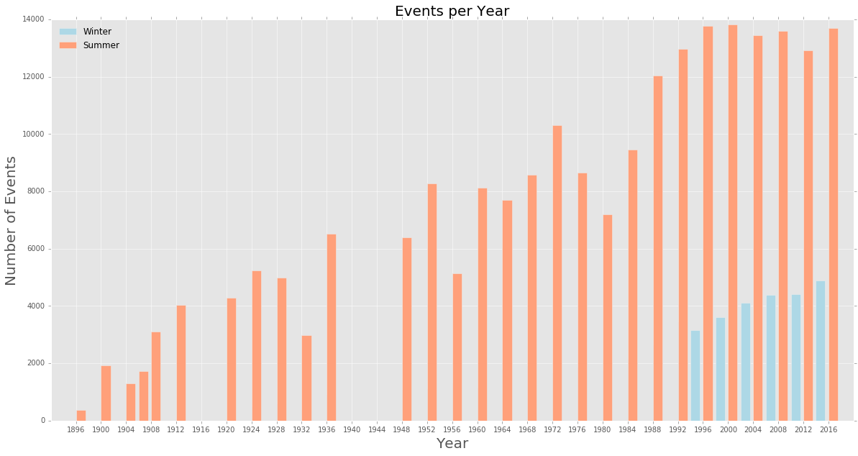
Summer VS. Winter in 120-year Olympic History Dataset

Slide 5
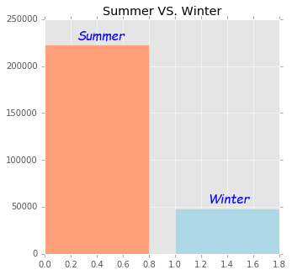
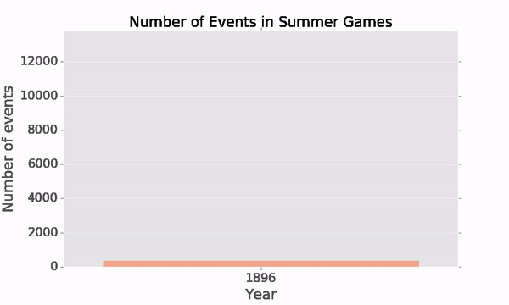

Slide 6
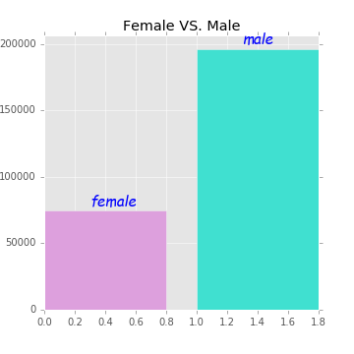
Gender Inequality
Number of male athletes is approximately 3 times of female athletes

Slide 7
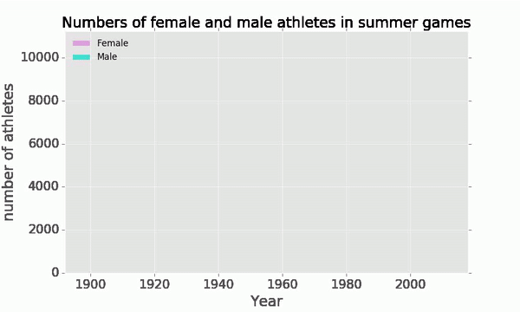
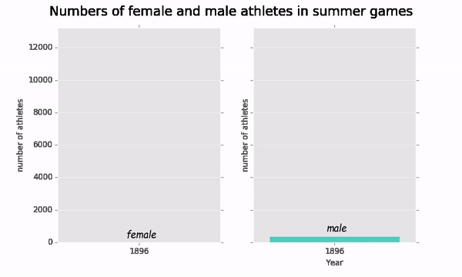
After World War II, the number of female athletes started increasing rapidly.
The gap between male and female athletes is getting smaller and smaller.

Slide 8
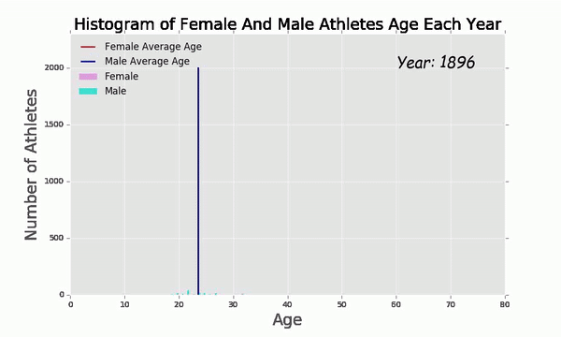
Age Distribution in Summer Games
The golden age for athletes is between 20 and 30.
The average age of athletes is increasing.
The average age of female athletes is lower than age of male.

Slide 9
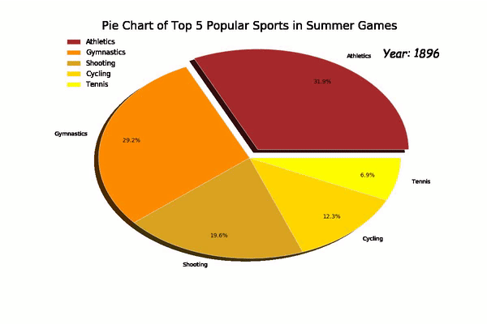
Most Popular Sports
Athletics, Gymnastics, and Swimming are always the most generalized sports in summer games.

Slide 10
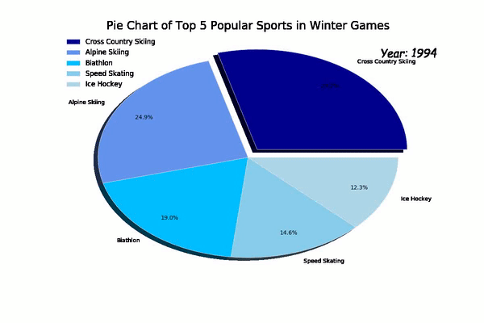
Cross country skiing is the biggest part of winter games.

Slide 11
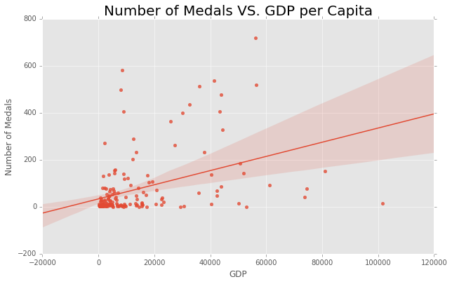
Correlation between number of medals and GDP in 2016
Almost Positively Correlated

Slide 12
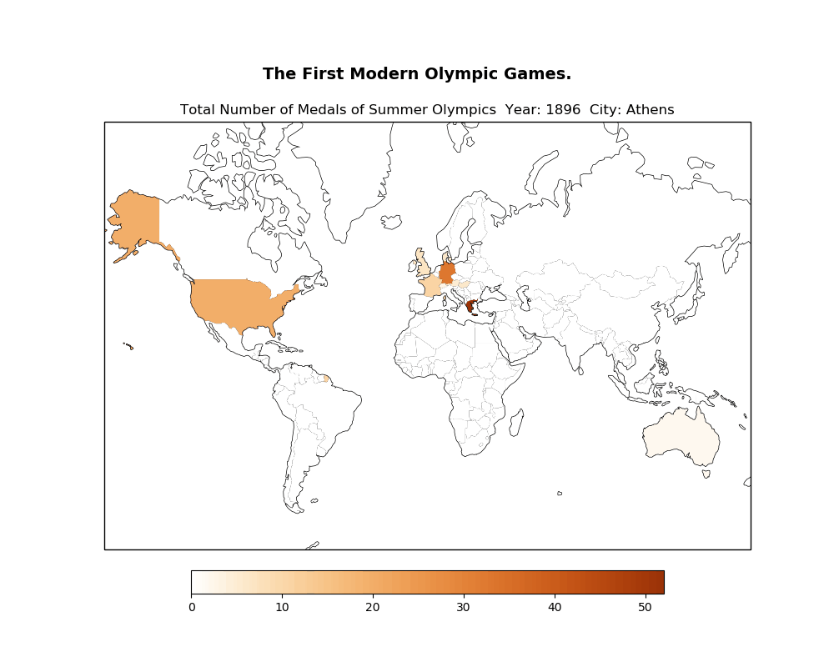
Medal Distribution around World of Summer Olympics Starting from 1896...
1936 Nazi Olympic
Soviet Union took the lead from 1952 until it collapsed(1991).
The US together with other 65 countries boycotted the 1980 Summer Games.
USSR led the boycott in 1984.

Slide 13
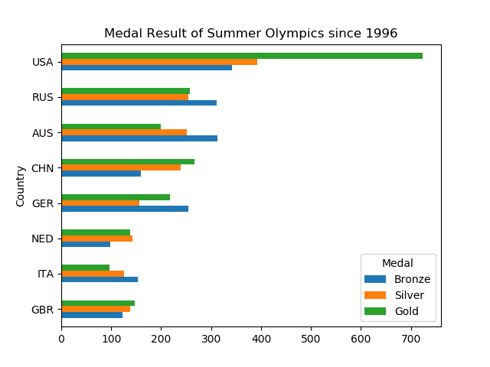
Summer Olympics Medal Result Since Last Twenty Years
USA has the absolute predominance in Summer
Olympics. Most of them come from Basketball, football, baseball and track and field.

Slide 14
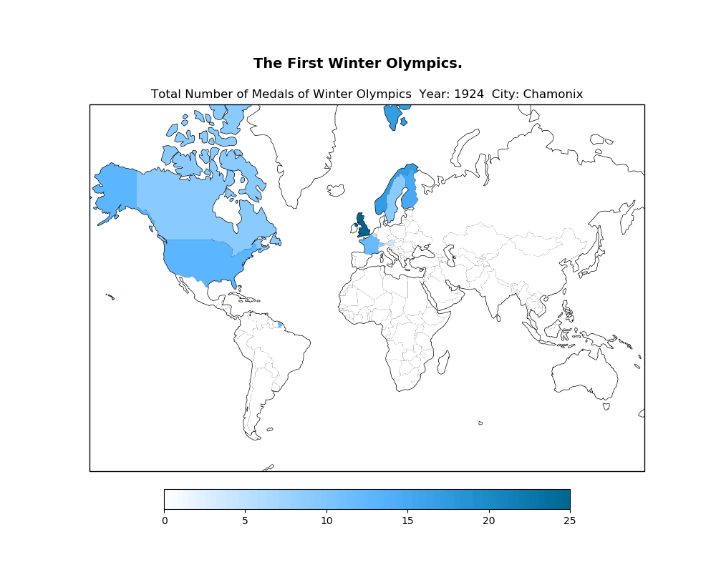
Medal Distribution around World of Winter Olympics Starting from 1924 ...
The International Olympic Committee voted to separate the Summer and Winter Games. (1994)
Suspension of the Russian Olympic Committee due to Olympic Doping.(2018)

Slide 15
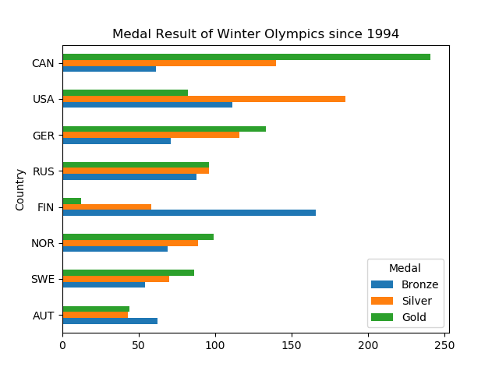
Winter Olympics Medal Result Since Last Twenty Years
Canada has the absolute predominance in Winter Olympics. Most of them come from Ice Hockey, Curling.
USA took most of the silver medals.
Finland took the most of the bronze medals.

Slide 16
Overview
Analyze height, weight, age, and region based trends overtime in the dataset
HP Filter
HP Filter analysis good for identifying long term trends
Very bad at short term trends
In general ill advised (did not know this going into this), however we found some interesting uses for HP Filter
PCA
PCA algorithm makes models PC1, PC2, PC3…PCn, with the most variance contained in PC1, and the least in PCn
We plotted PC1 vs. PC2 to visualize which years contributed the most to the total deviation in each of the 4 analyzed variables throughout history

Slide 17
Statistical Analysis for Trend Analysis
Hodrick-Prescott decomposition is generally used to create a time series analysis of economic data
The series is composed of three parts, a trend component 𝛕_{t} , a cyclical component c_{t}, and an error component ϵ_{t}, such that the series is described as y_{t} = 𝛕_{t} + ϵ_{t} +c_{t}
We looked for consistent trends over time and confirmed these were not due to outliers by performing Principal Component Analysis
Ex: What are the trends in age over time in Alpine Skiing?

Slide 18
Principal Component Analysis
Principal component analysis uses orthogonal transformation to create a transform of a set of potentially correlated variables to a set of linearly uncorrelated variables (principal components).
Plotting and the principal components and looking at the distribution along the x-axis will tell us if the values are in fact uncorrelated
Analyzing the first two principal components takes into account the vast majority of variance in a dataset, so we plot these against each other
In summary, we looked for clear trends in HP analysis across multiple trend/cycle lines and looked for nonuniform distributions in PCA graphs.

Slide 19
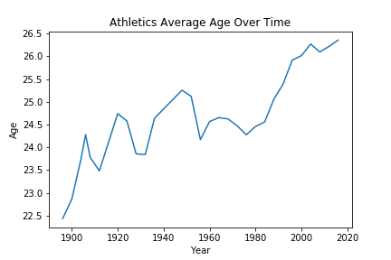
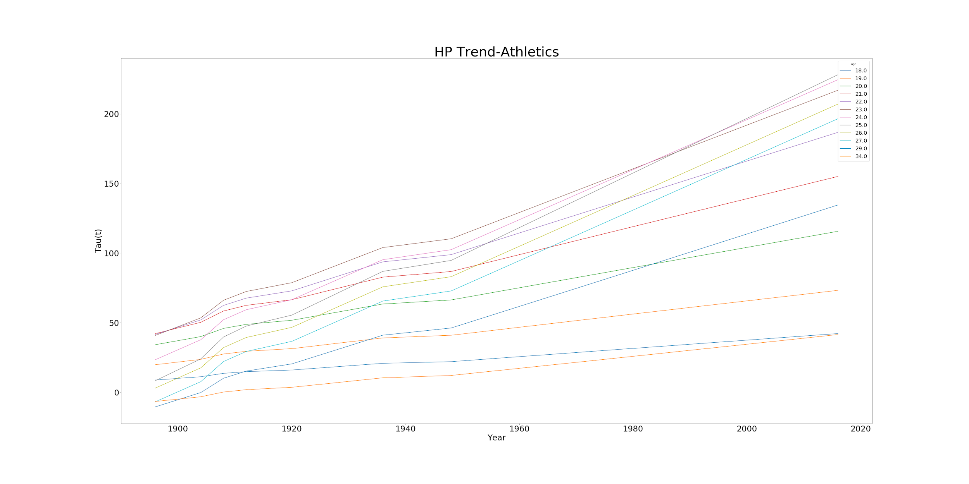
HP Filter is great for removing noise in long term trends

Slide 20
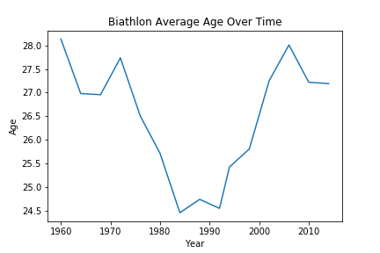
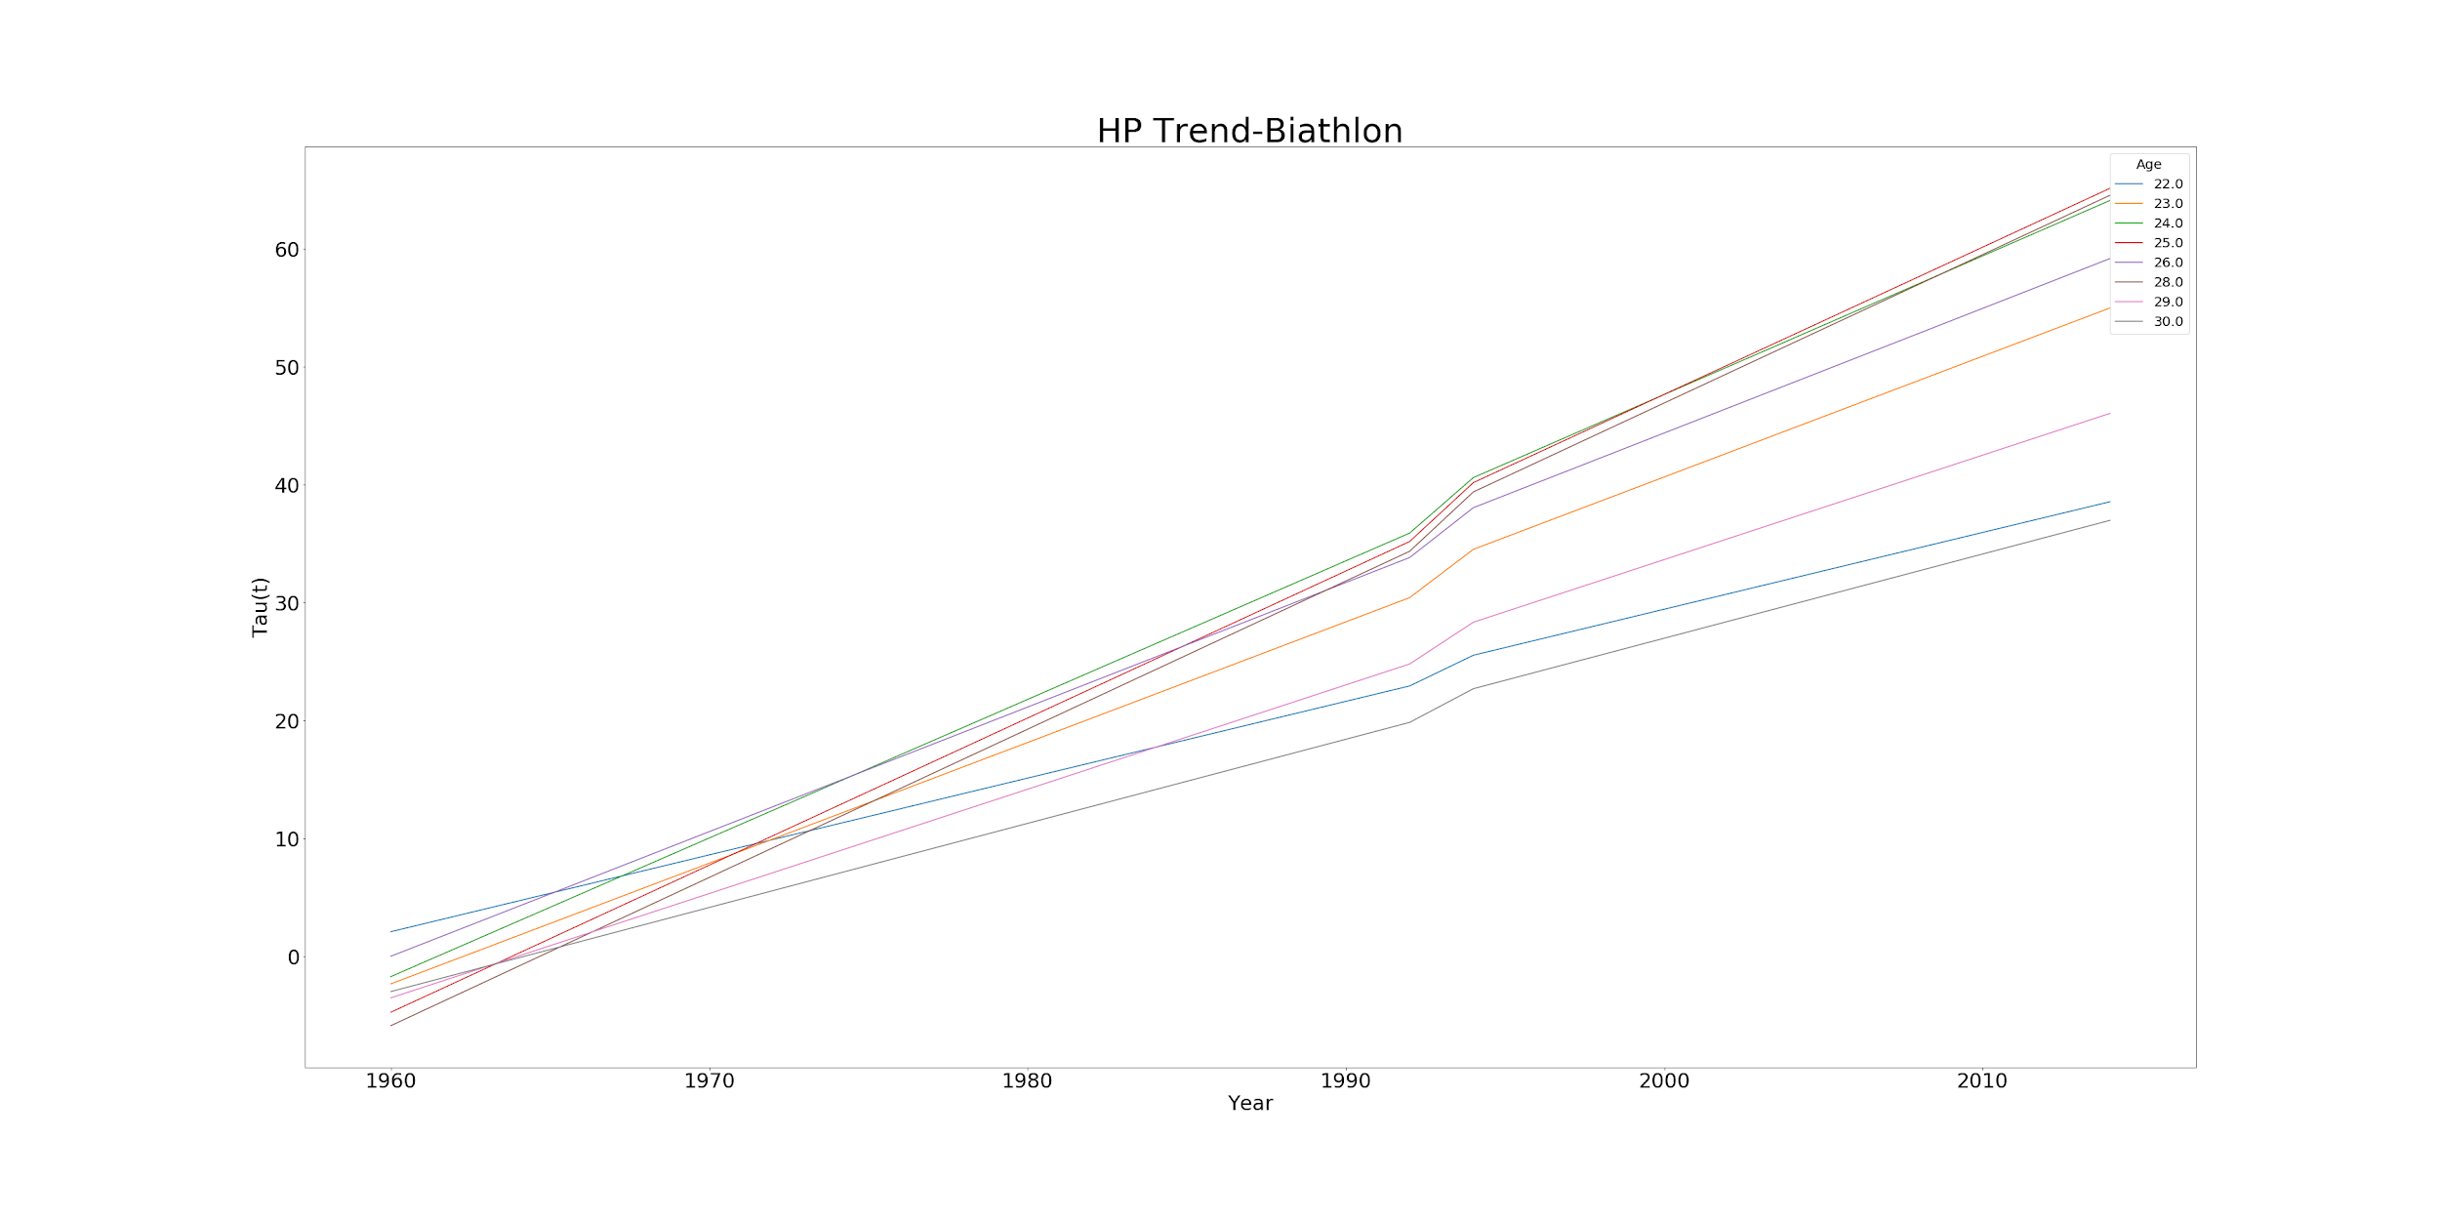
HP Filter is bad at analyzing sudden trends

Slide 21
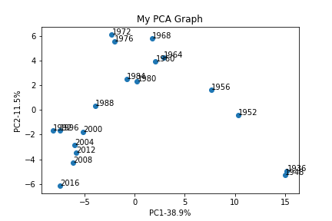
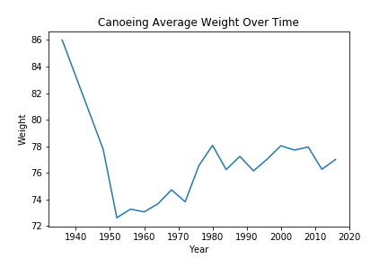
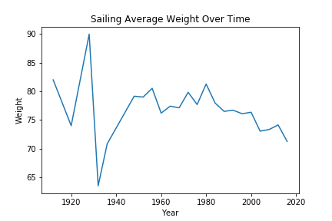
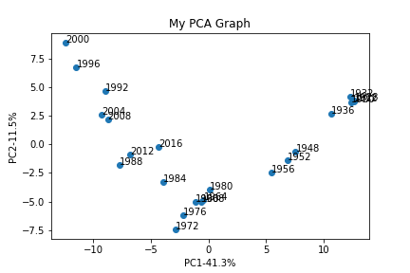
PCA overfits time-course distributions to drastic changes

Slide 22
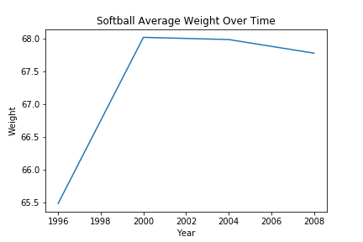
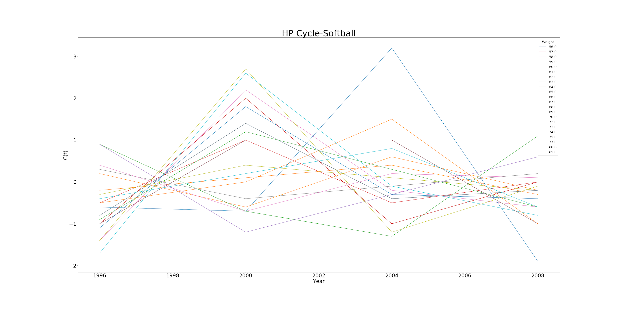
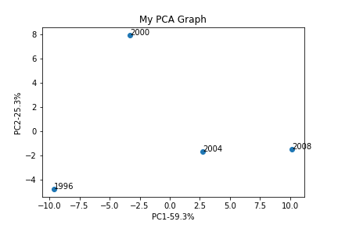
Inflection Pattern
Softball average weights increased drastically in short time period from 1996 to 2008
If systematic, we should see lower weights decrease and larger weights increasing in frequency at the the same time
We can see this trend in the inflection in the HP cycle graph.
PCA shows this single 4 year spike accounted for the vast majority of weight shifts over time in softball

Slide 23
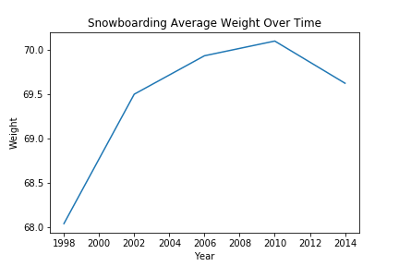
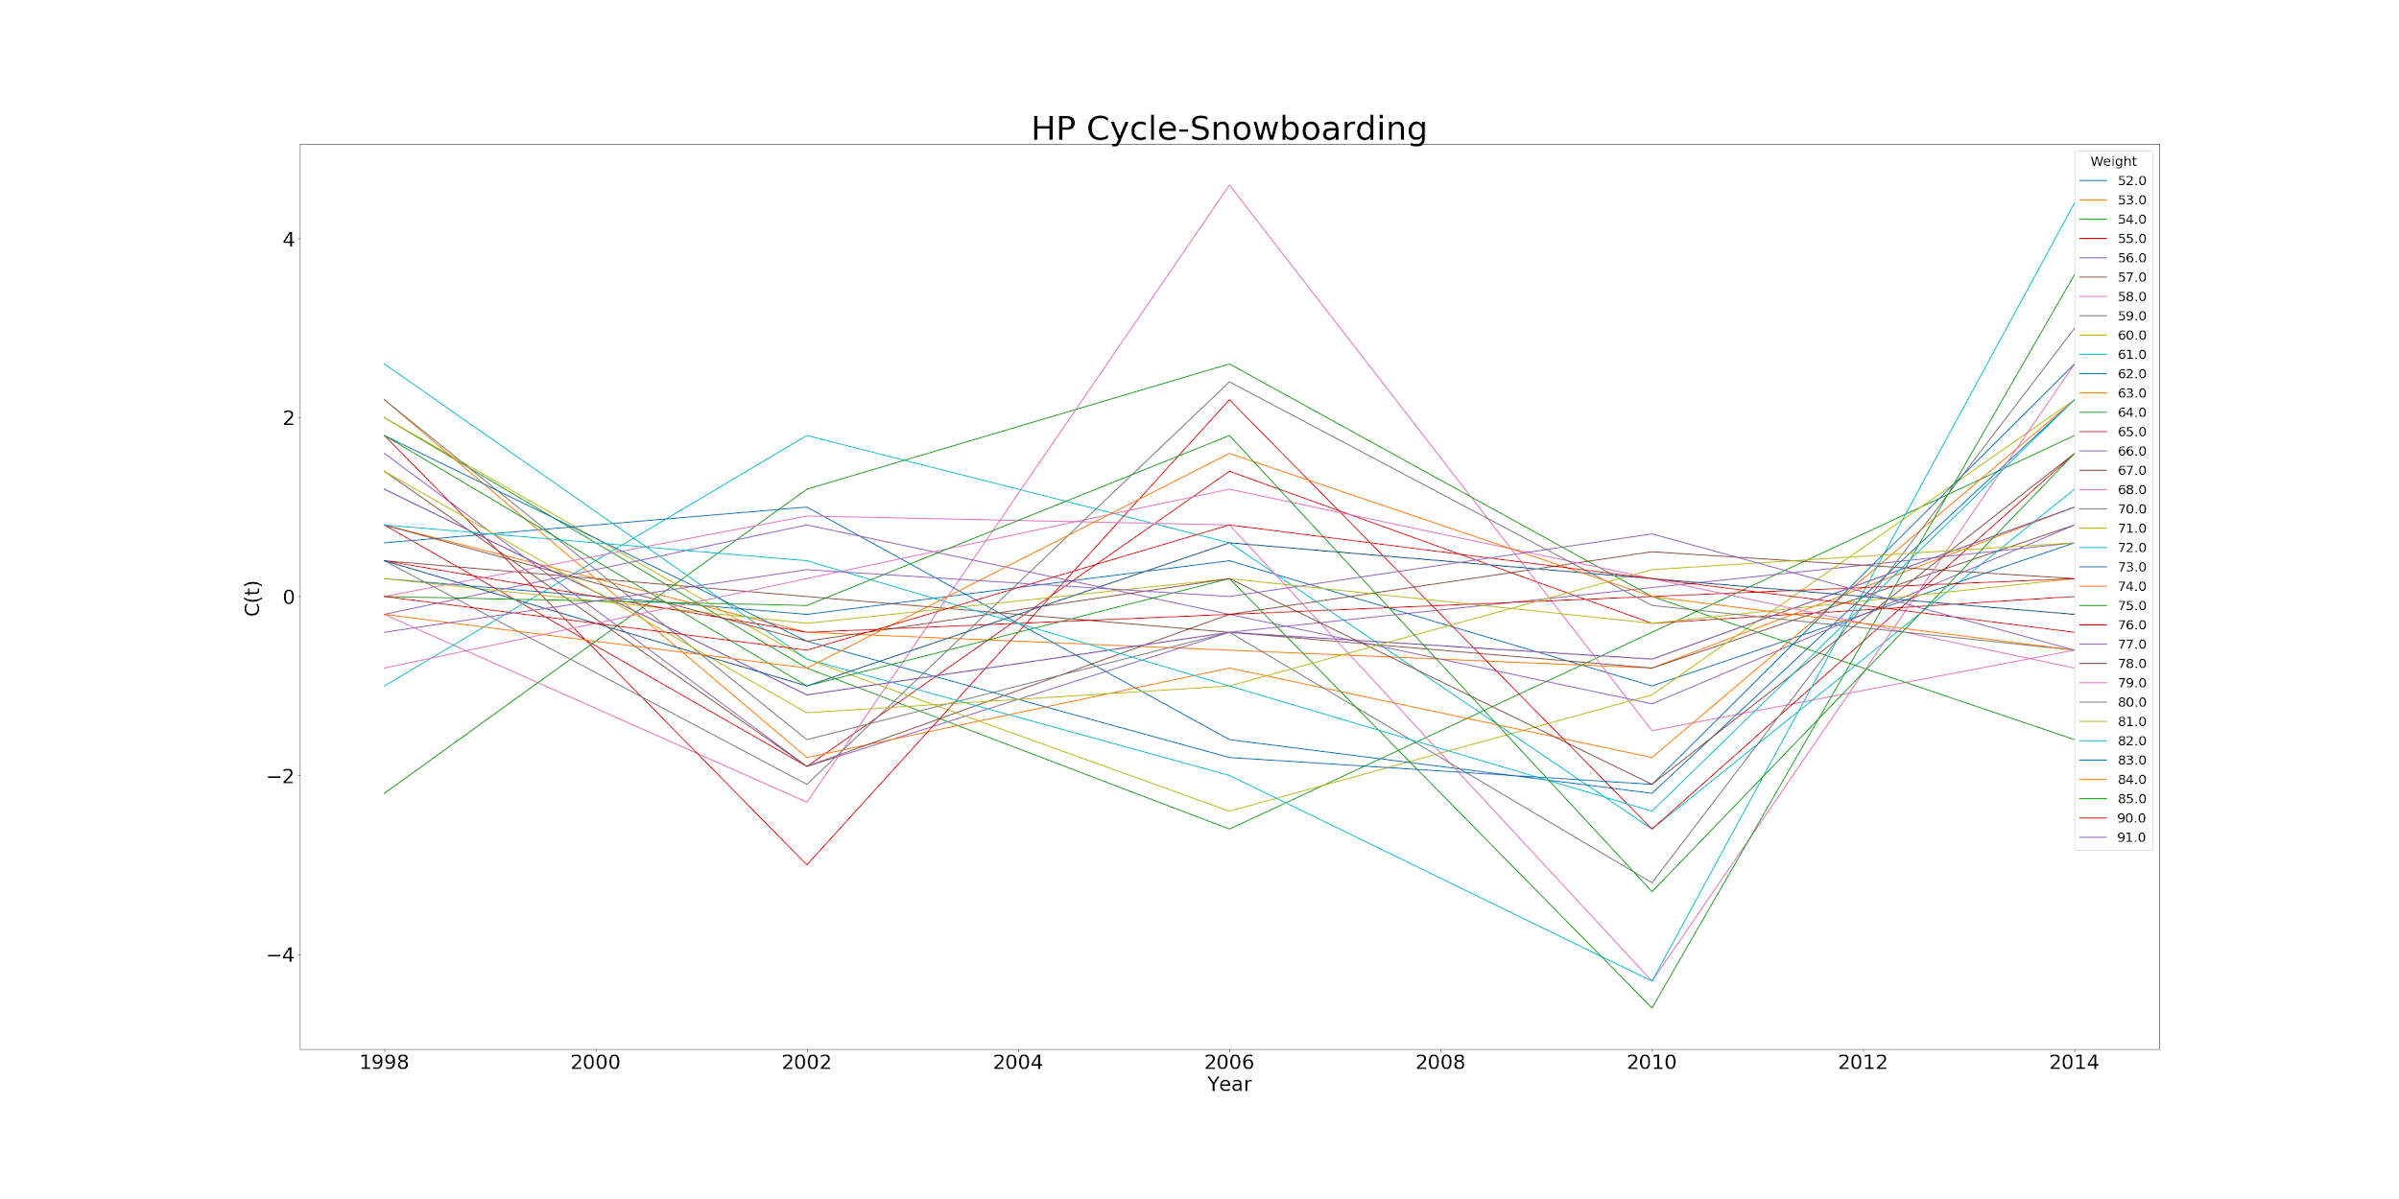
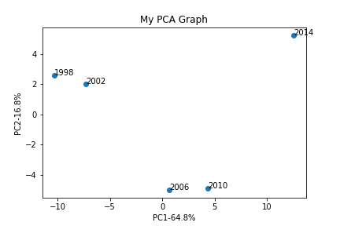
Inflection Pattern
Snowboarding Olympian average weights increased significantly from 1998 to 2010
Same trend as we saw in softball data
Strong inflection in 2012 ⇒ can we predict that snowboarding average weight will continue to decrease for some time?

Slide 24
Thank You!

